Slide 1
Portfolio Website

Slide 2
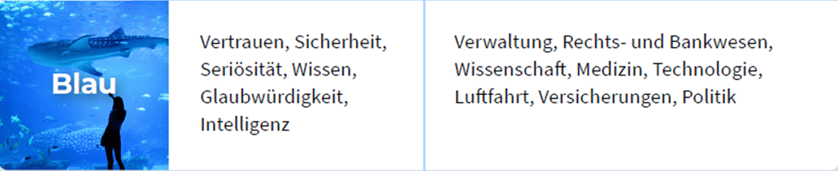
Colors

Slide 3
Colors

Slide 4
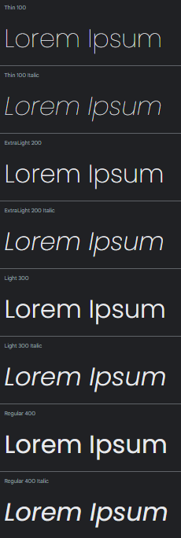
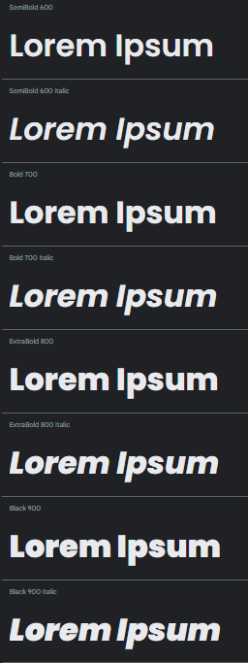

Font
https://fonts.google.com/specimen/Poppins
Poppins

Slide 5

Navigation

Slide 6
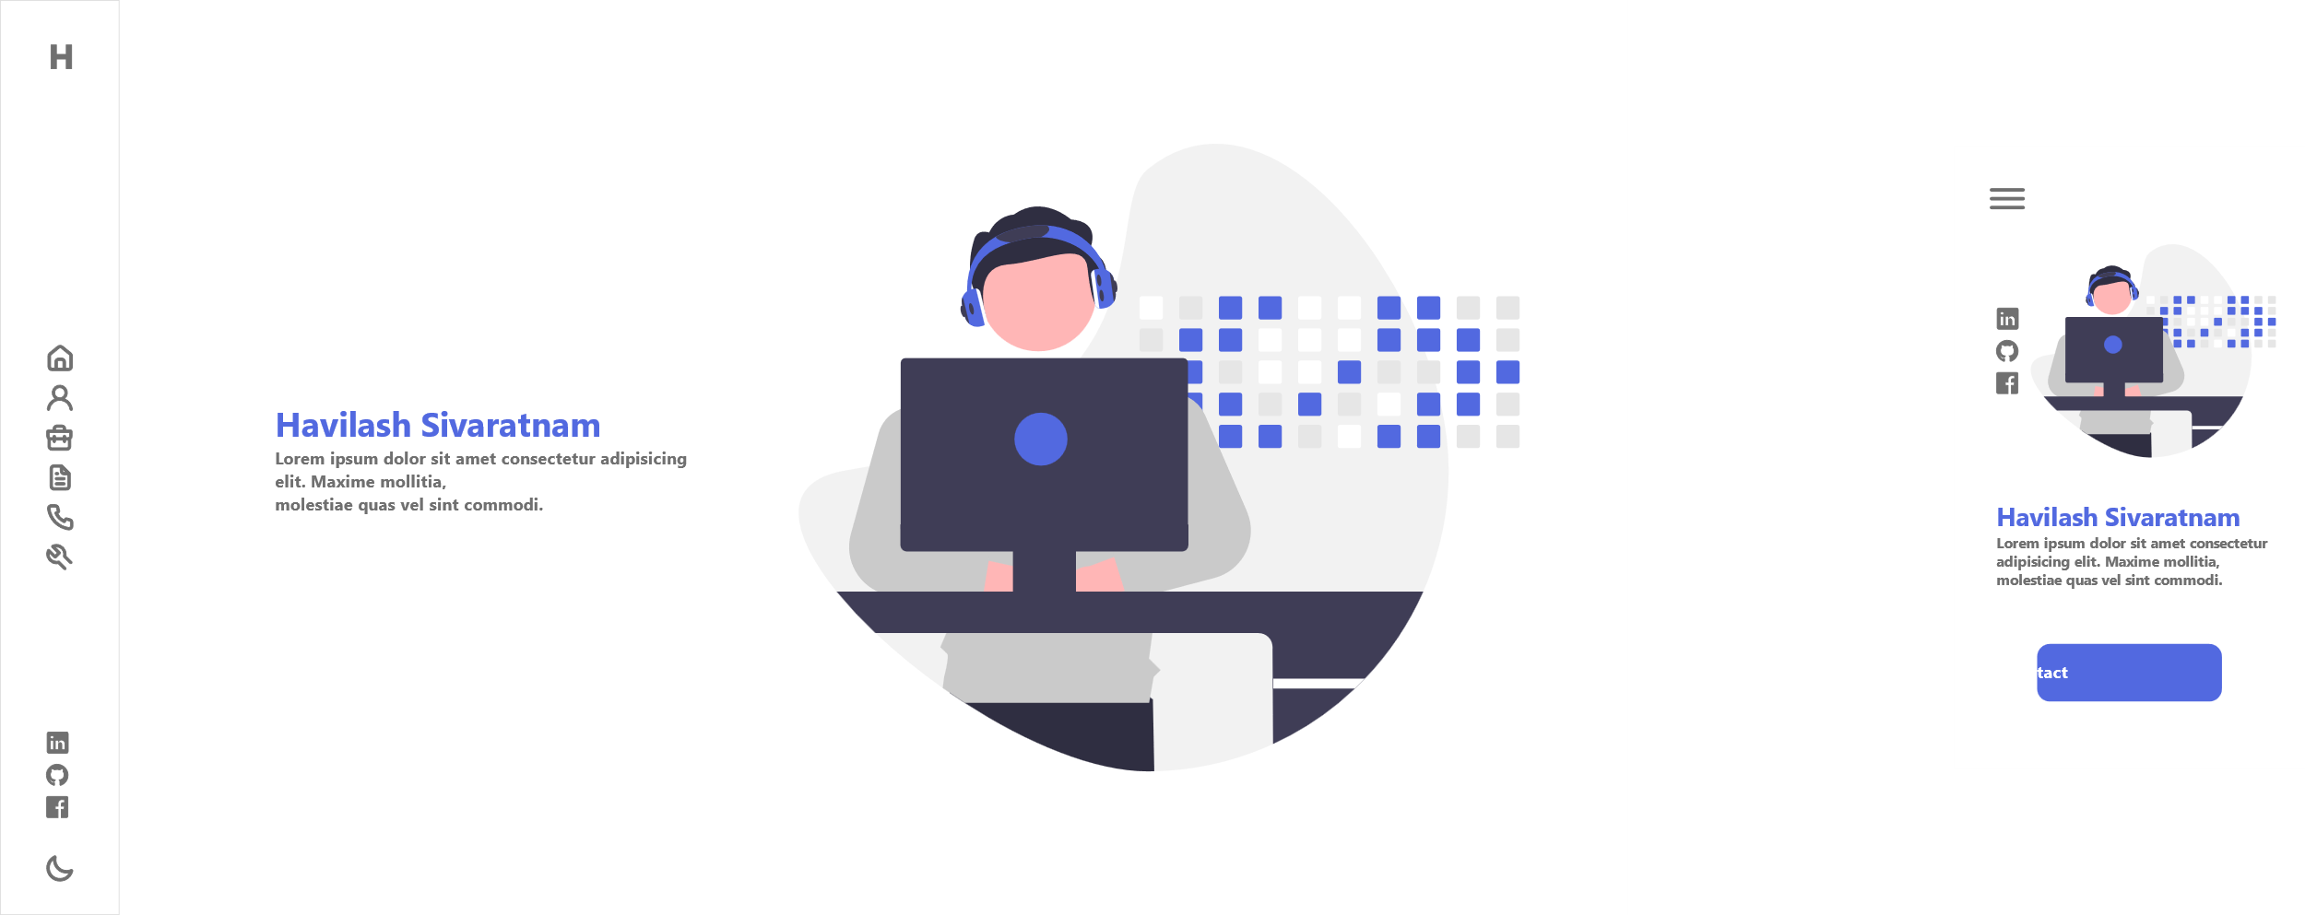
Home

Slide 7
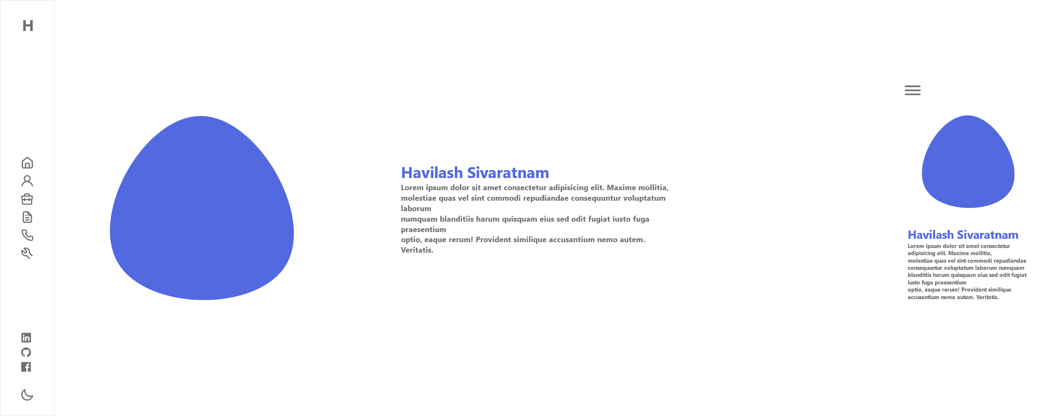
About Me

Slide 8
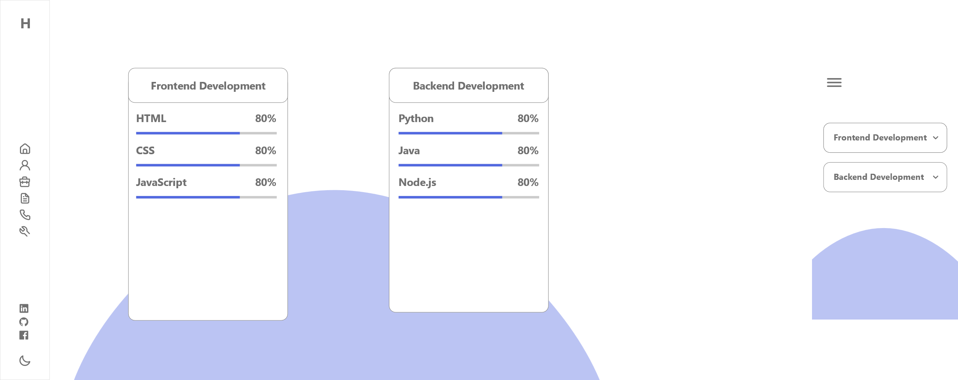
Skills

Slide 9
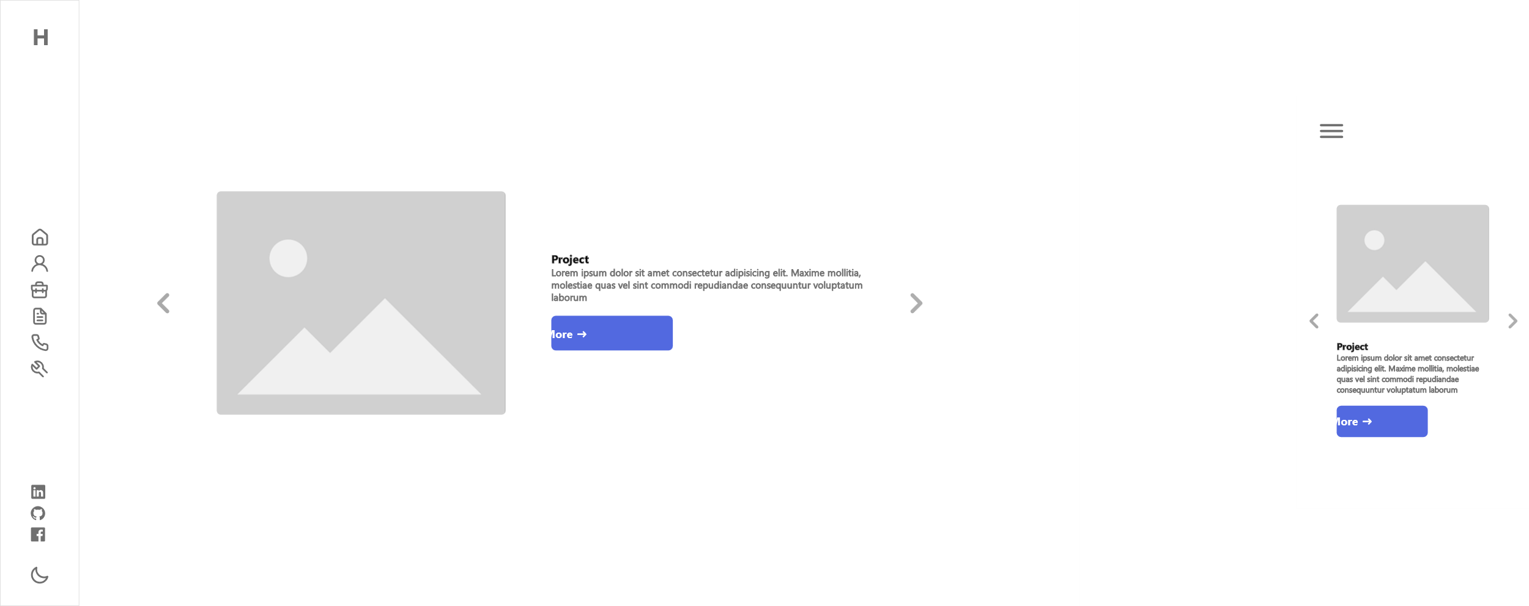
Projects

Slide 10
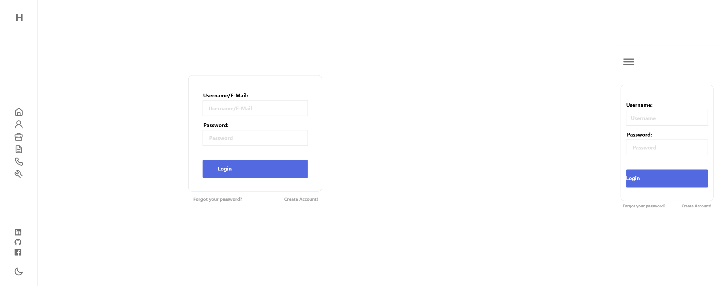
Login

